Slide 1
CAPSTONE PROJECT
NOP COMMERCE AUTOMATION TESTING
JAVA SELENIUM BATCH -3
GUDIED BY: Vishal GUPTA
SUBMITTED BY: Hemanjali Muli

Slide 2
Project overview
The project focuses on automating the testing process of the nopCommerce demo web application (https://demo.nopcommerce.com/).
A Selenium WebDriver + TestNG based framework is developed to validate core functionalities such as user registration, login, product search, cart, checkout, and order management.
The framework follows the Page Object Model (POM) design for reusability and maintainability.
Maven is used for build and dependency management, ensuring smooth integration of libraries and plugins.
The framework is integrated with Jenkins CI/CD pipeline to enable automatic execution of tests on each code commit, ensuring continuous feedback to developers.
GitHub is used for version control and collaboration, allowing seamless team integration.
JIRA is used for requirement tracking, test case management, defect tracking, and project monitoring, ensuring visibility and traceability throughout the SDLC.
The project ultimately delivers a robust, scalable, and maintainable automation framework, ensuring application stability and faster release cycles.

Slide 3
TYPES OF TESTING UTILIZED
1. Manual Testing :
Executed in Jira Zephyr.
Test Cases created manually for :
Positive Scenarios
Negative Scenarios
Edge Cases
Defects logged directly in Jira when tests fail.

Slide 4
2. Automated Testing
Implemented using:
Selenium WebDriver → Automates browser interactions.
TestNG Framework → Manages test flow and data-driven tests.
Page Object Model (POM) → Modular code structure.
Core Automated Functionalities:
Login & Registration
Product Search & Filter
Add to Cart & Checkout
Wishlist & Password Reset
3. CI/CD Based Testing
Integrated with Jenkins for Continuous Integration:
Automatically executes tests on every GitHub commit.
Generates ExtentReports with screenshots for every pass/fail step.

Slide 5
PROJECT DESCRIPTION – NOPCOMMERCE AUTOMATION CAPSTONE
The objective of this capstone project is to develop a robust, end-to-end
automated testing framework for the nopCommerce demo e-commerce
application (https://demo.nopcommerce.com/).
The framework focuses on automating key functional areas such as:
User Registration & Login
Product Search & Filter
Add to Cart & Checkout Process
Wishlist, Review, and Password Reset functionalities.

Slide 6
DESCRIPTION OF MY WORK
Requirement Analysis and Planning:
1.Understood the functionalities of the nopCommerce demo website
2.Identified test scenarios for core modules like login, Registration, Product Search, Add to Cart and Checkout.
Framework Design & Development:
1.Built a Selenium Webdriver+ TestNG automation Framework
2.Followed Page Object Model(POM) for code reusability and maintainability.
3.Configured Maven for dependency management and project build.
Test Case Implementation:
Designed test suites with TestNG annotations for organized execution and cross browser testing support.

Slide 7
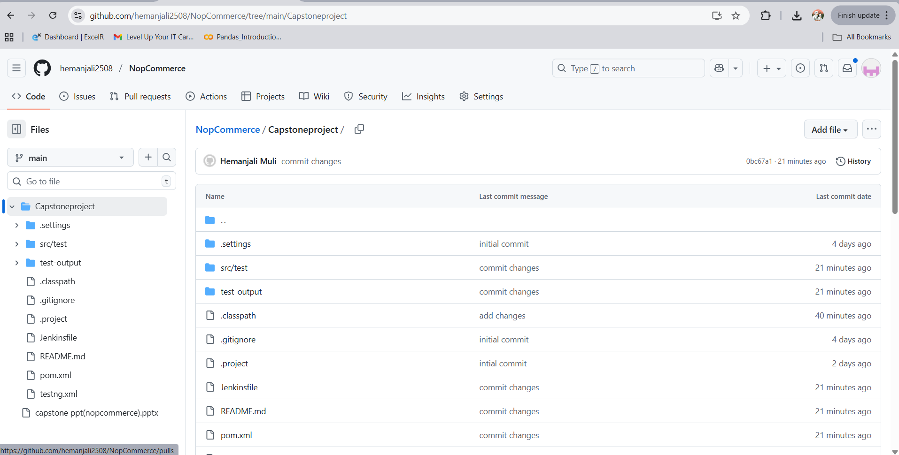
AUTOMATION FRAMEWORK SCREENSHOT FROM GIT REPOSITORY

Slide 8
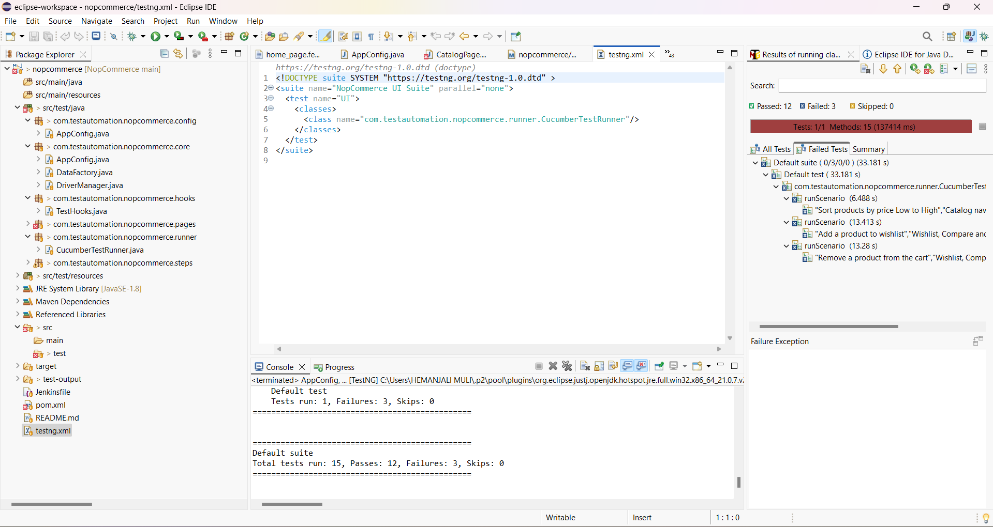
AUTOMATION APPROACH,PAGE OBJECT MODEL AND DATA DRIVEN TESTING SCREENSHOT

Slide 9
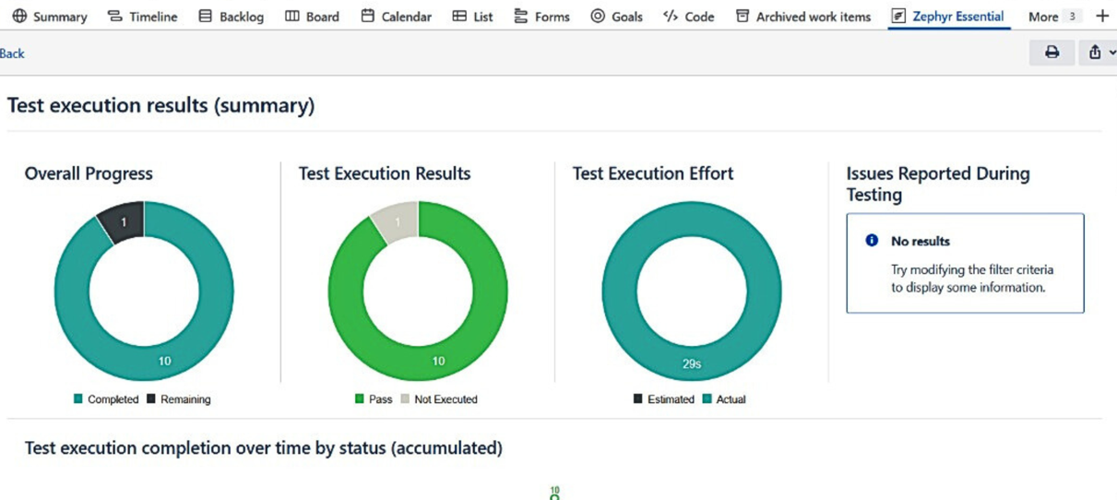
Zephyr reports

Slide 10
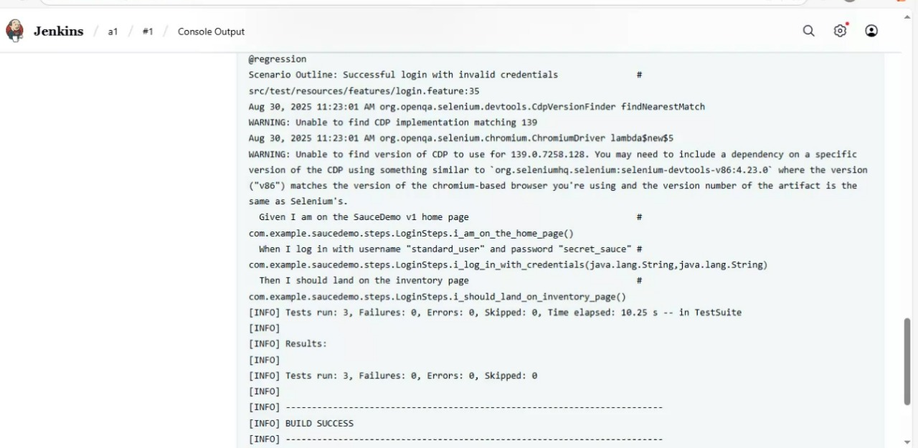
Jenkins for ci/cd

Slide 11
Conclusion
The capstone I have done has demonstrated the development of a fully integrated, automated testing and CI/CD pipeline for a web application using the nopCommerce demo site.
I achieved through this project is:
Robust automated testing
Seamless CI/CD integration
Effective version control
Improved software quality and delivery

Slide 12


